Slide 1

Project Title - Healthcare Analytics for Doctor Visits
[STU6a07fdf0488dd1778908656 ]

Slide 2

PROBLEM STATEMENT
Healthcare organizations struggle to predict patient visit frequencies and manage resource allocation efficiently.
Lack of clear visibility into how socioeconomic status, chronic illnesses, and demographic factors influence patient healthcare utilization.
High demand for automated, data-driven insights to help clinics and hospitals understand patient visit patterns.

Slide 3
Project Description
Developed an end-to-end exploratory data analysis and visualization pipeline in Python using the Doctor Visits healthcare dataset.
Cleaned, preprocessed, and analyzed 5,190 patient records covering demographics, income levels, illness counts, and insurance coverage.
Generated comprehensive statistical summaries and visual distributions using Pandas, NumPy, Seaborn, and Matplotlib to uncover underlying utilization drivers.

Slide 4

WHO ARE THE END USERS?
Healthcare Providers & Clinics: To anticipate patient volumes and streamline clinical staffing.
Hospital Administrators: For resource planning and understanding demographic healthcare demands.
Insurance Analysts: To evaluate risk profiles across different coverage categories (private, free-poor, free-repat).
Researchers & Data Scientists: As a foundational analytics framework for advanced predictive modeling.

Slide 5

Technology Used
Core Language: Python
Data Processing & Analysis: Pandas, NumPy
Data Visualization: Matplotlib, Seaborn
Development Environment: Python Data Science Stack & Jupyter Environment

Slide 6
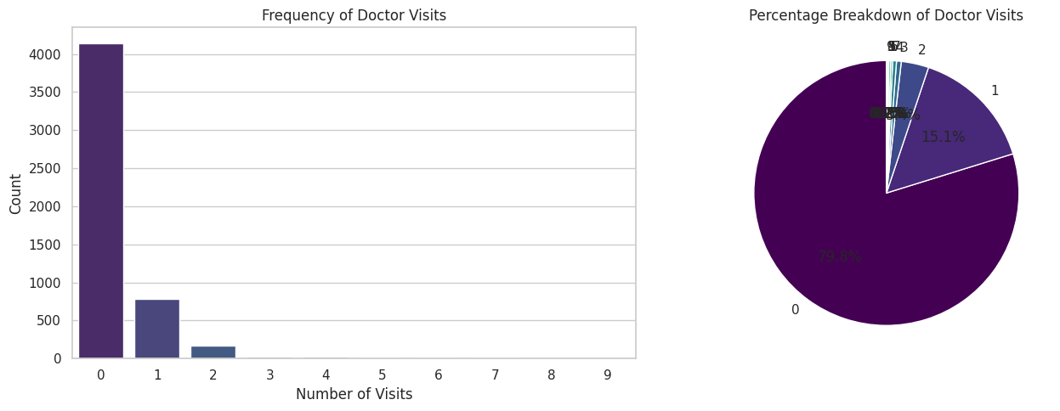
RESULTS
Demo Link

Slide 7
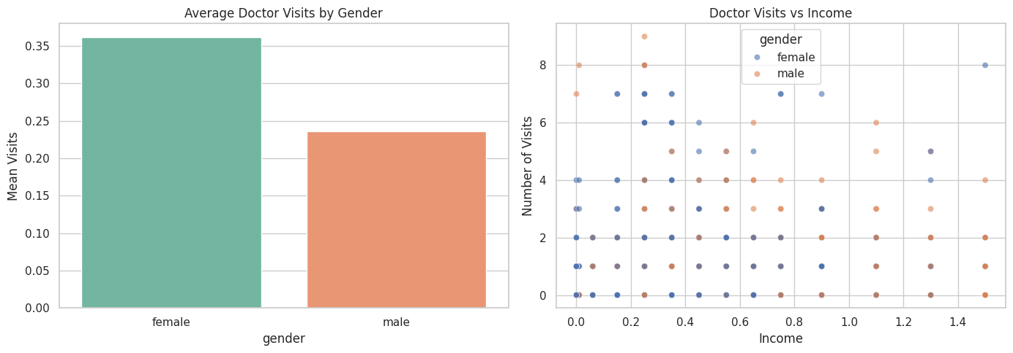

Slide 8
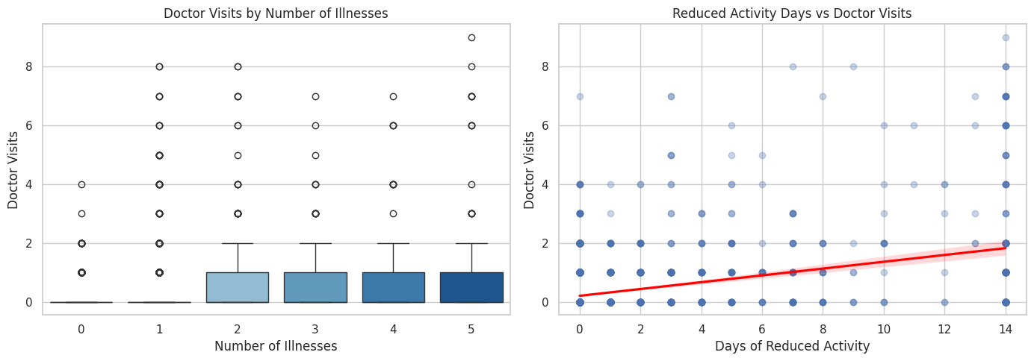

Slide 9
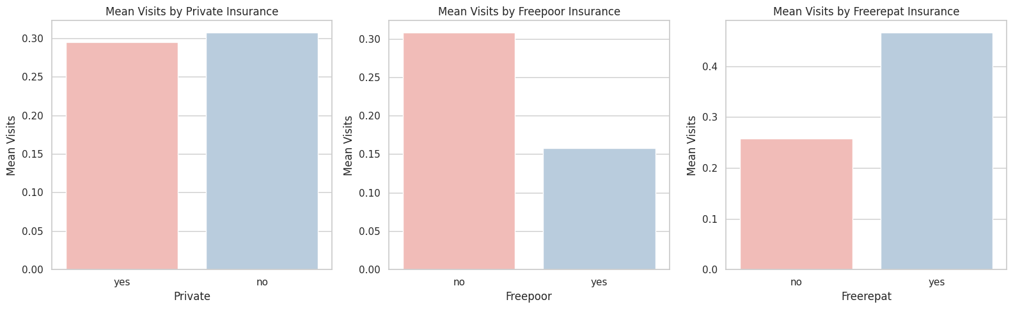

Slide 10
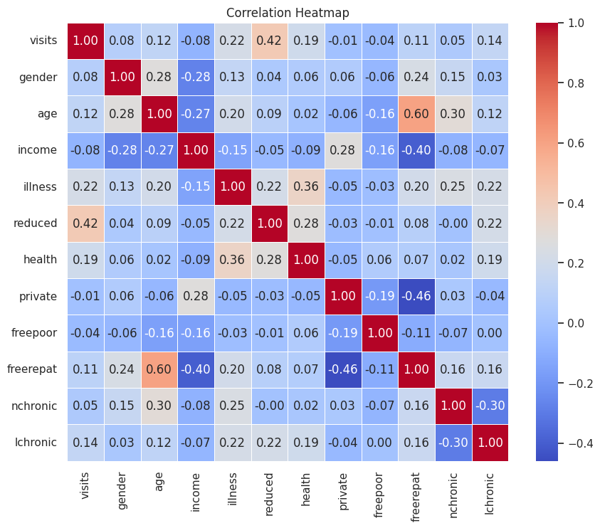

Slide 11
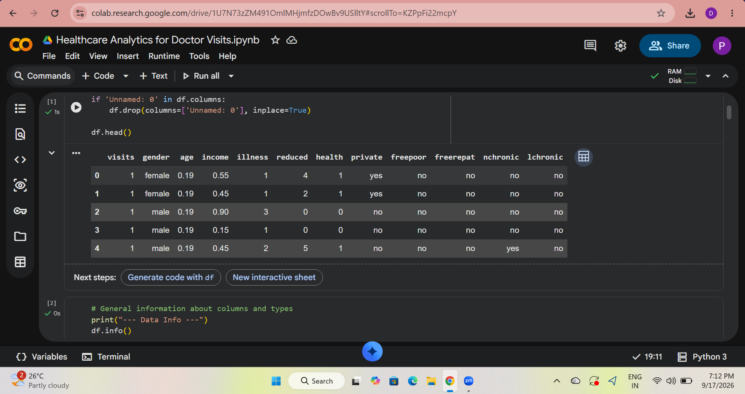

Slide 12
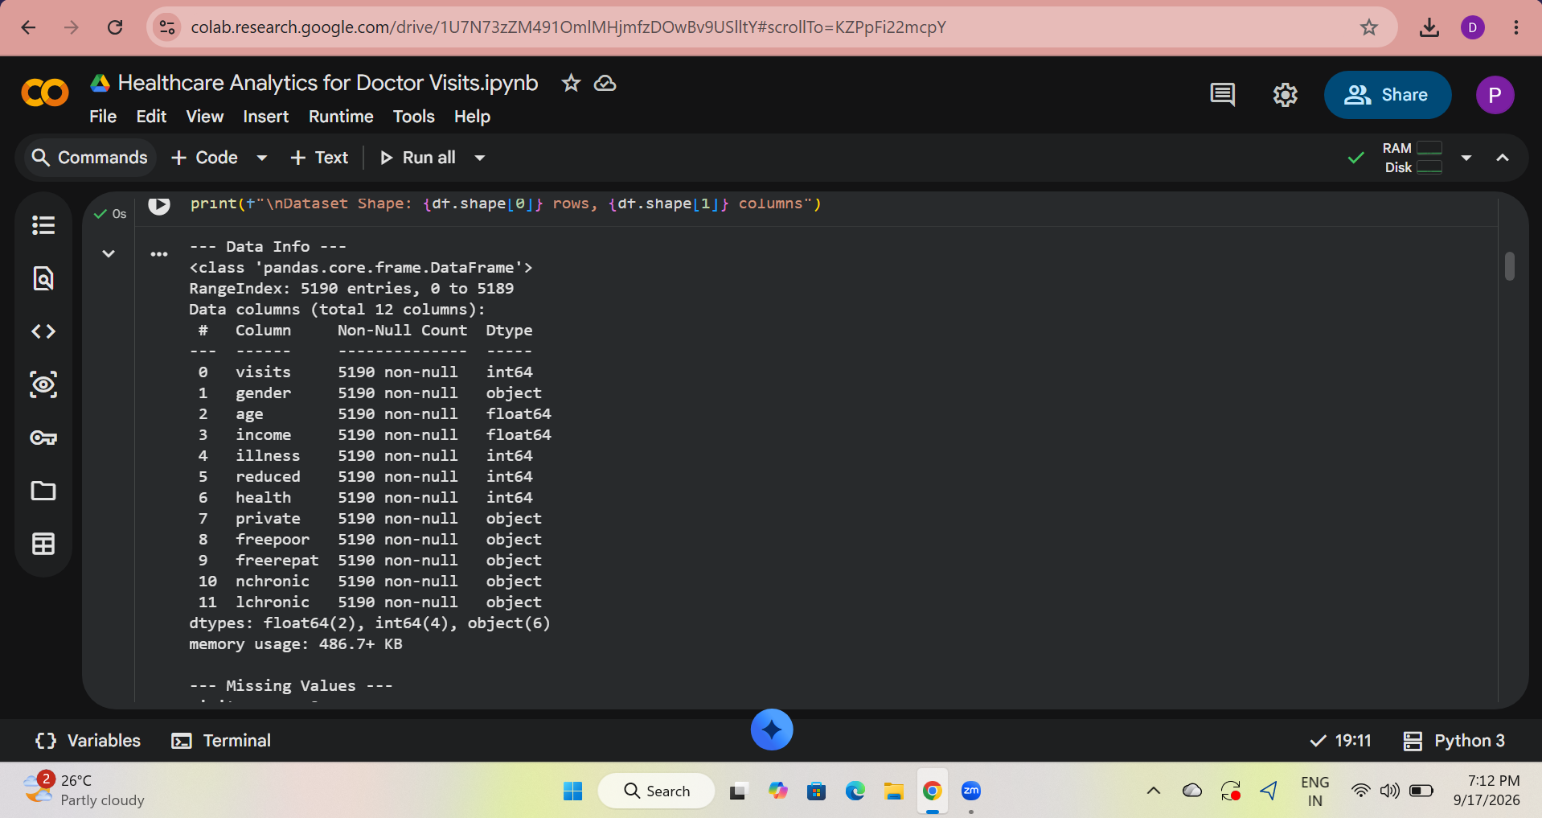

Slide 13
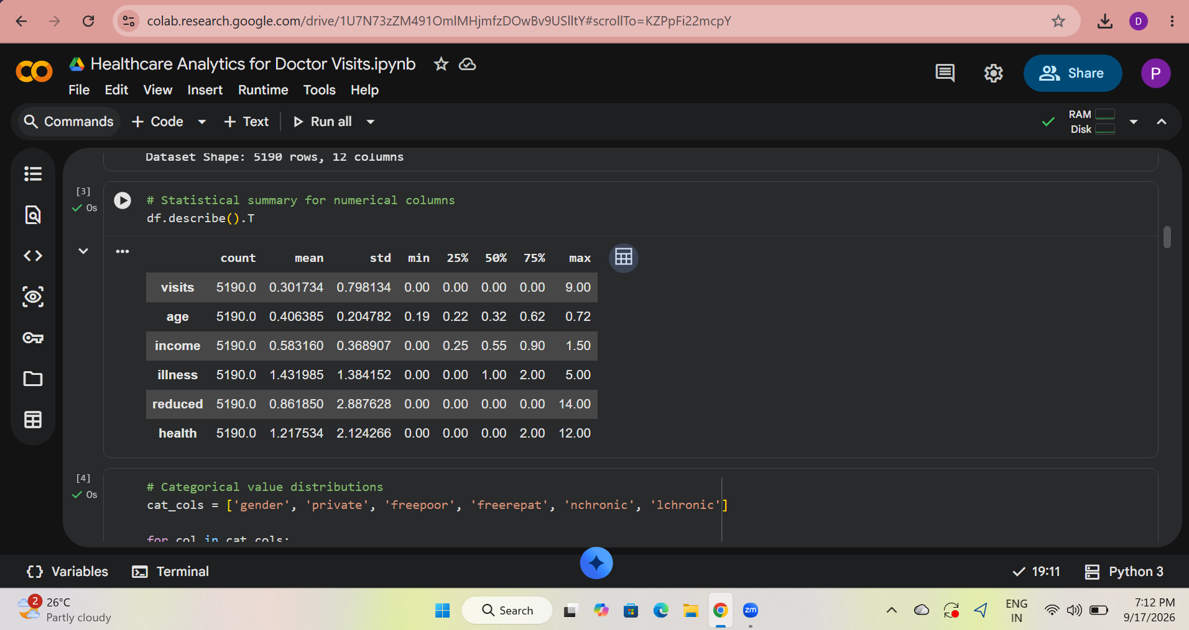

Slide 14
Link :
https://github.com/mrsonu-boop/Healthcare-Analytics-for-Doctor-Visits

Slide 15
Thank you
.
.

